Slide 1
Algorithm Trading Market Making Simulation
Guoqin Huang
Xiaowen Wang

Slide 2
1. Data 2. Strategies 3. Performance Analysis

Slide 3
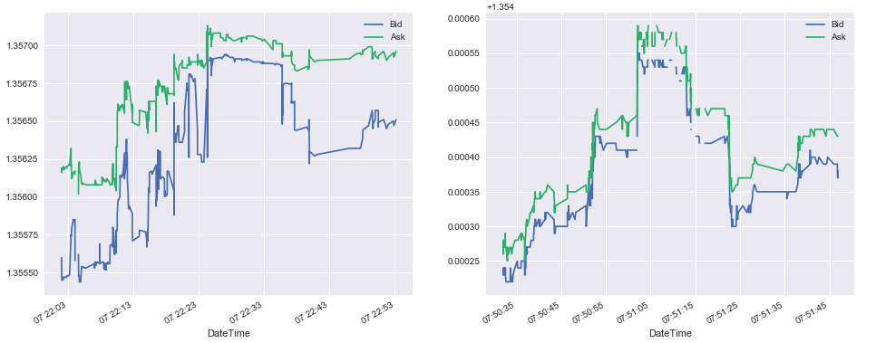
1. Data
2018-01-07
2018-01-08

Slide 4
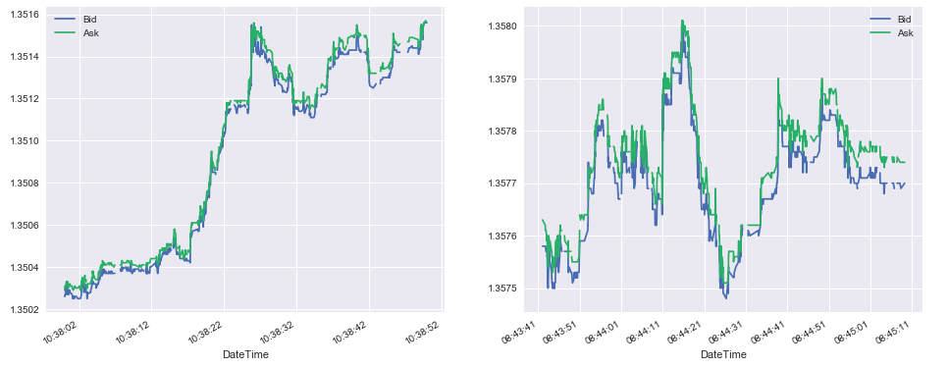
1. Data
2018-01-10
2018-01-12

Slide 5
2. Strategies

Slide 6
2. Strategies: Market-Follower
Quote exactly the same as the market price
But our quote is 10 milliseconds later than the market price observed
Every time we observed market price, we give out the same Bid/Ask price

Slide 7
2. Strategies: Position-Watcher
Focus on the Net Open Position
Not want to be exposed to a large open position
Act differently in 4 situations

Slide 8
2. Strategies: Position-Watcher
When -3 < Net Open Position < 3:
Act aggressively
Take orders as more as possible
Market Bid + 20% X (B/A Spread)
Market Ask – 20% X (B/A Spread)

Slide 9
2. Strategies: Position-Watcher
When -7 < Net Open Position < -3
or 3 < Net Open Position < 7:
Act neutrally
Follow the market price to give our quote
Market Bid
Market Ask

Slide 10
2. Strategies: Position-Watcher
When Net Open Position < -7
Act actively in Bid and passively in Ask
Increase chance of taking sell orders
Market Bid + 20% X (Spread)
Market Ask + 20% X (Spread)

Slide 11
2. Strategies: Position-Watcher
When Net Open Position > 7
Act actively in Ask and passively in Bid
Increase chance of taking buy orders
Market Bid - 20% X (Spread)
Market Ask - 20% X (Spread)

Slide 12
2. Strategies: Trend-Follower
MA 20 :
Moving Average of the Past 20 Bid/Ask Price
MA 5:
Moving Average of the Past 5 Bid/Ask Price

Slide 13
2. Strategies: Trend-Follower
If MA 5 > MA 20 :
Assume the market has a trend going up
Take more sell orders
Market Bid + 20% X (Spread)
Market Ask + 20% X (Spread)

Slide 14
2. Strategies: Trend-Follower
If MA 5 < MA 20 :
Assume the market has a trend going down
Take more buy orders
Market Bid - 20% X (Spread)
Market Ask - 20% X (Spread)

Slide 15
3. Performance Analysis

Slide 16
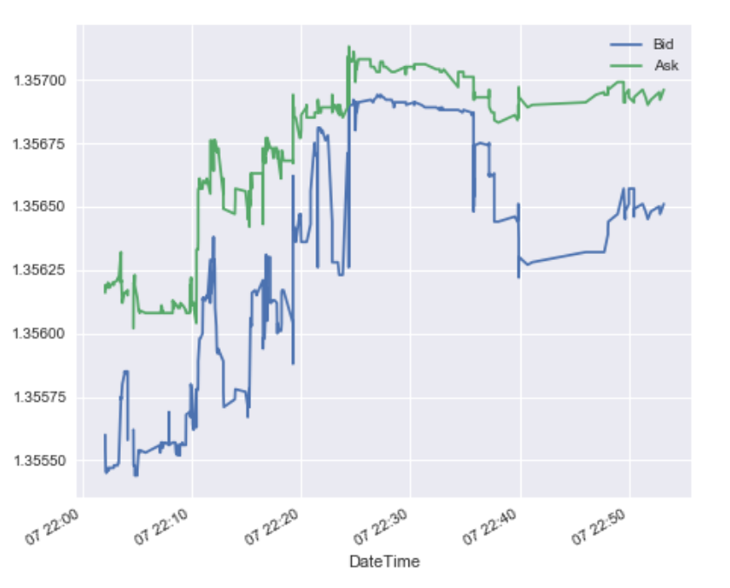
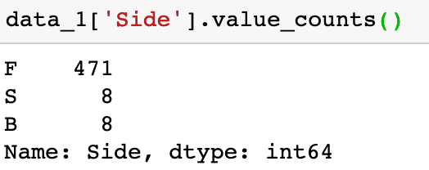
Order Period - 1
Mean Reversion
Small volatility and b/o spread
Volume and participation are balanced

Slide 17
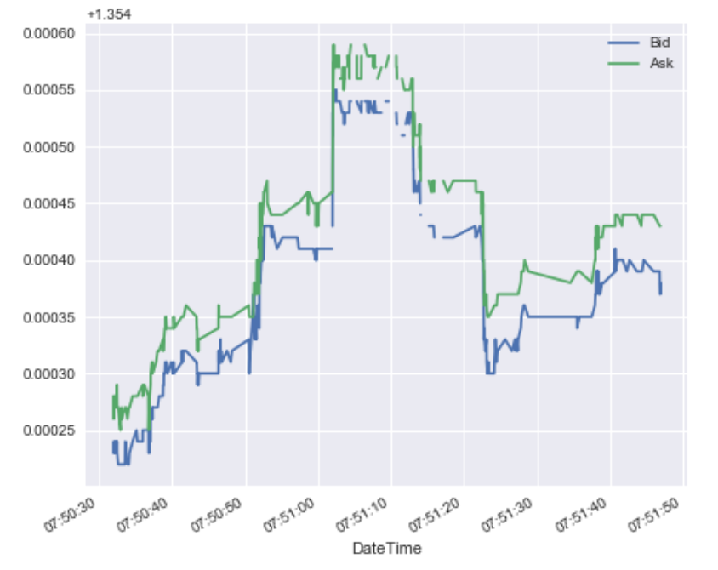
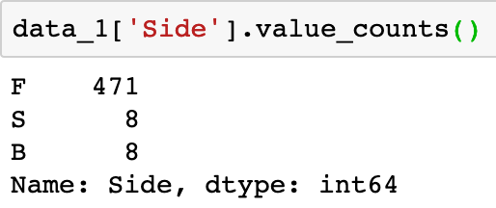
Order Period - 2
Mean Reversion
Small volatility and b/o spread
Volume and participation are balanced

Slide 18
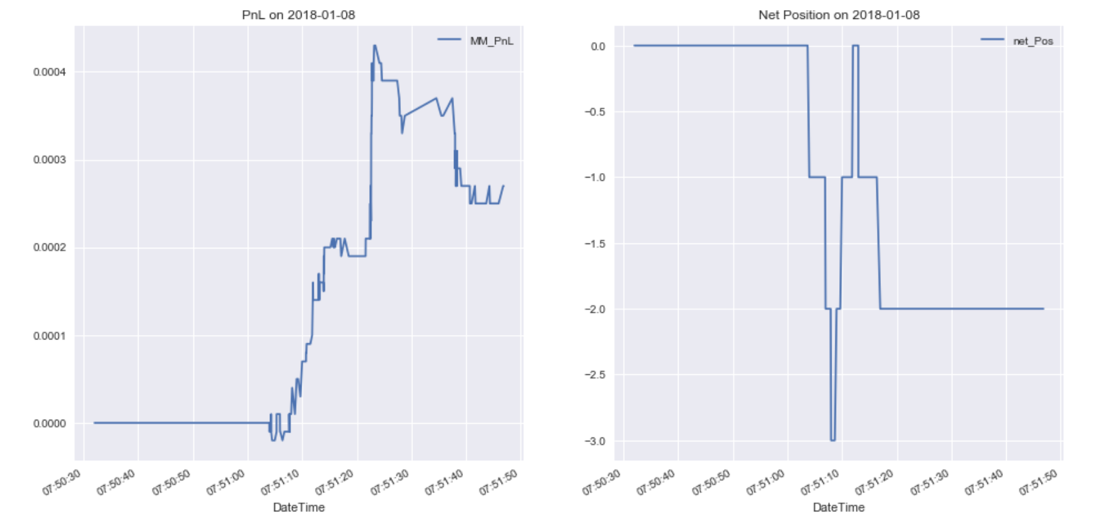
Market-Follower Strategy

Slide 19
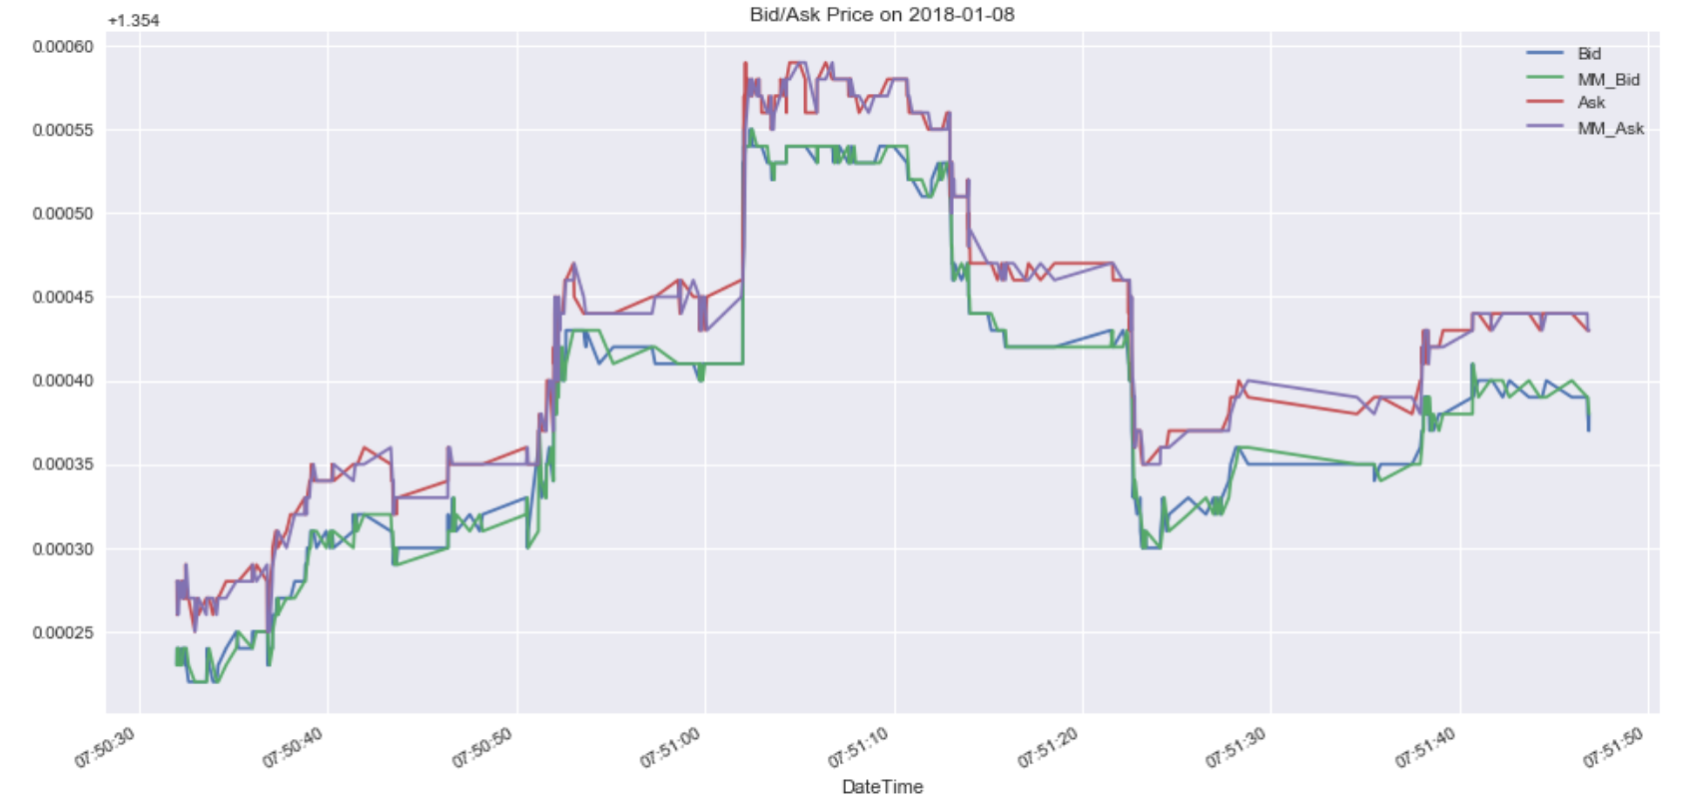

Slide 20
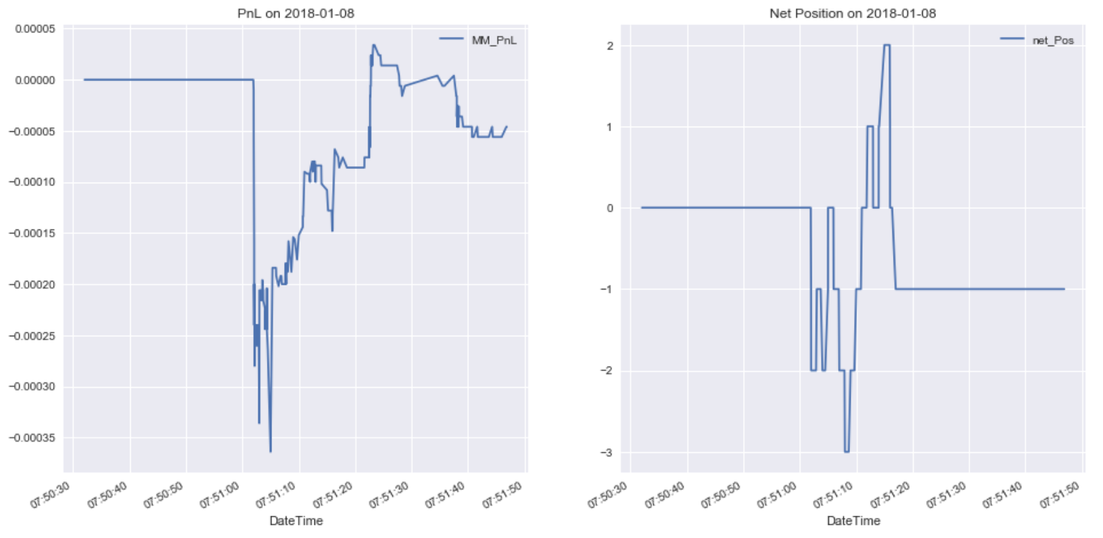
Position-Watcher Strategy

Slide 21


Slide 22
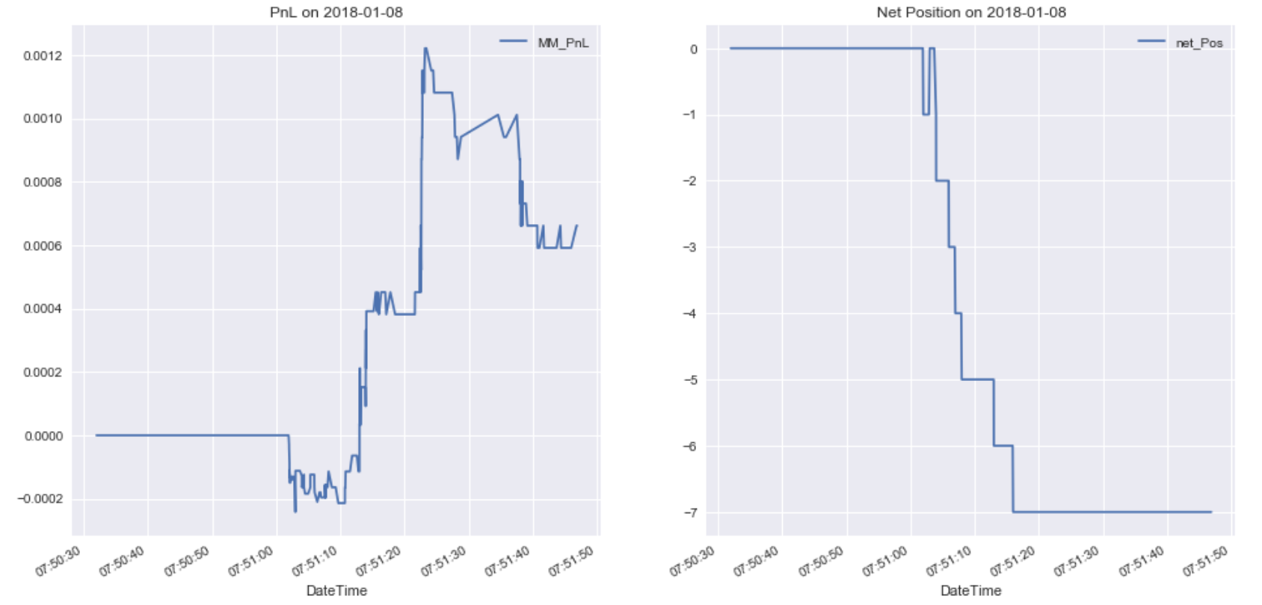
Trend Follower Strategy

Slide 23
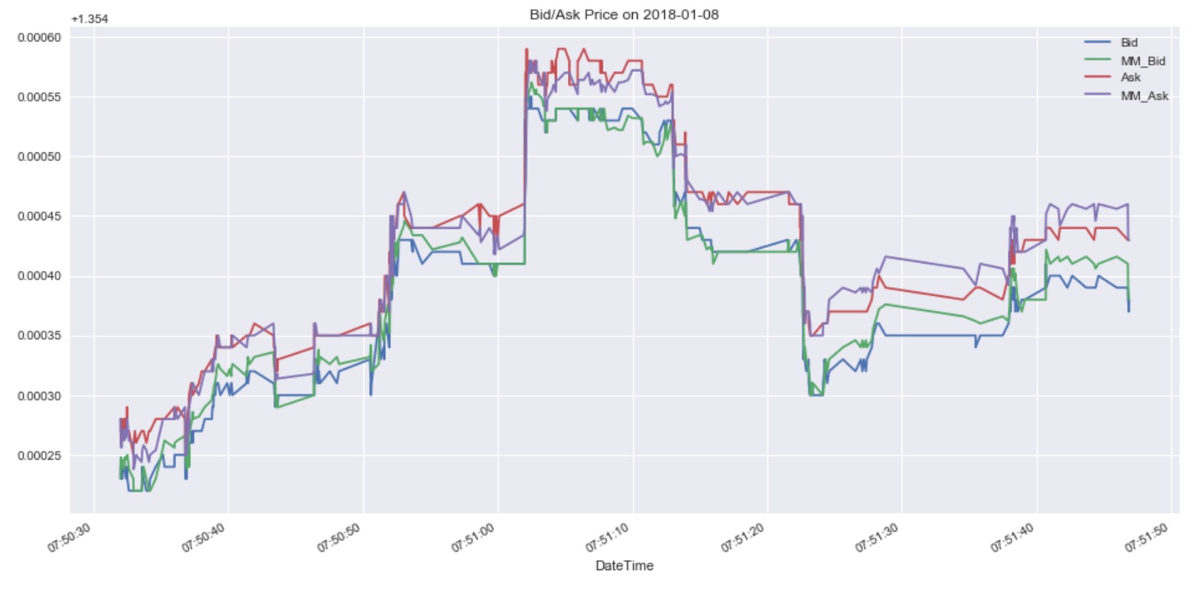

Slide 24
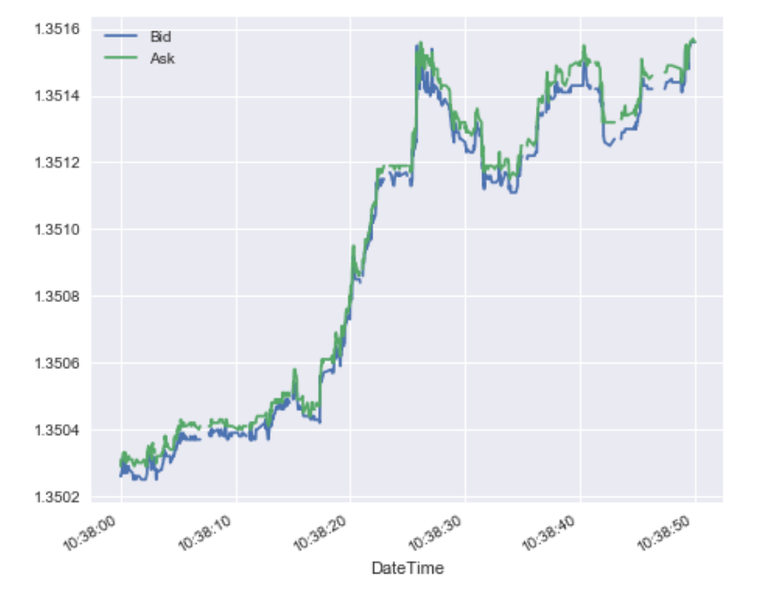
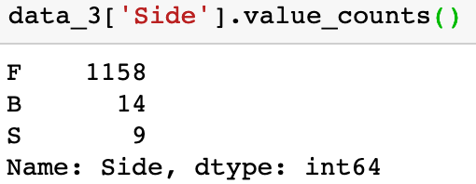
Order Period - 3
Dislocation
Participation is unbalanced
volatility and b/o spread are large

Slide 25
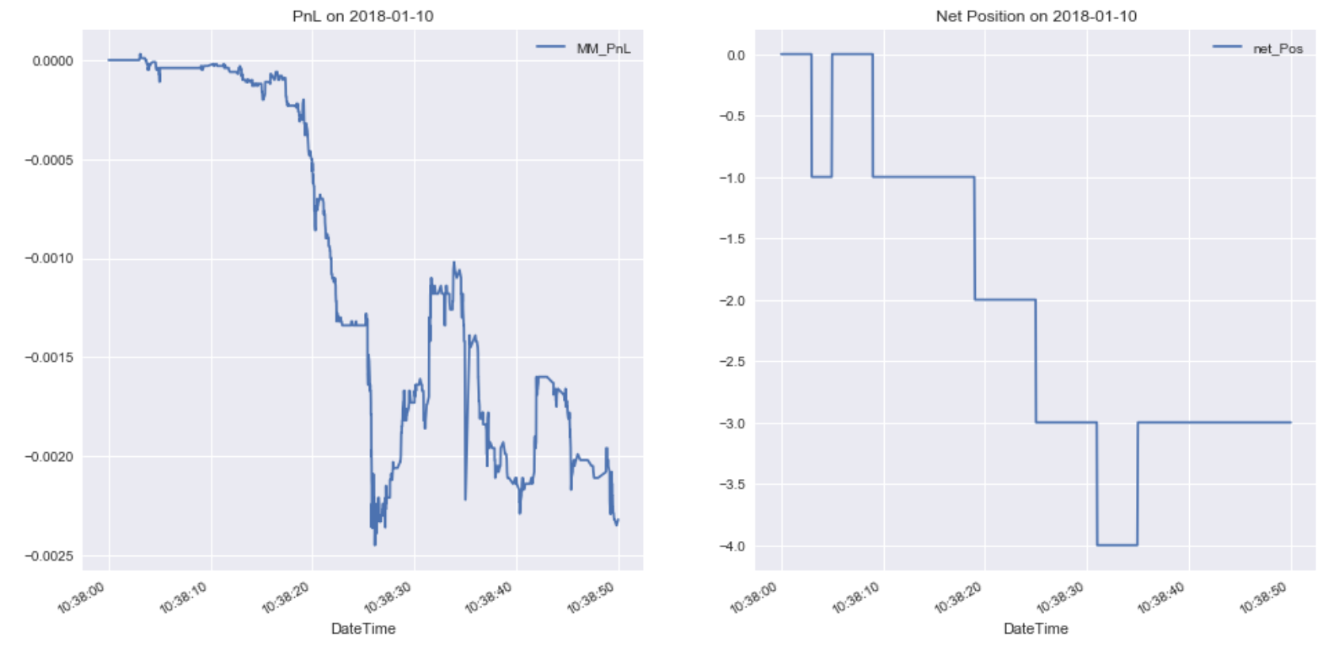
Market-Follower Strategy

Slide 26
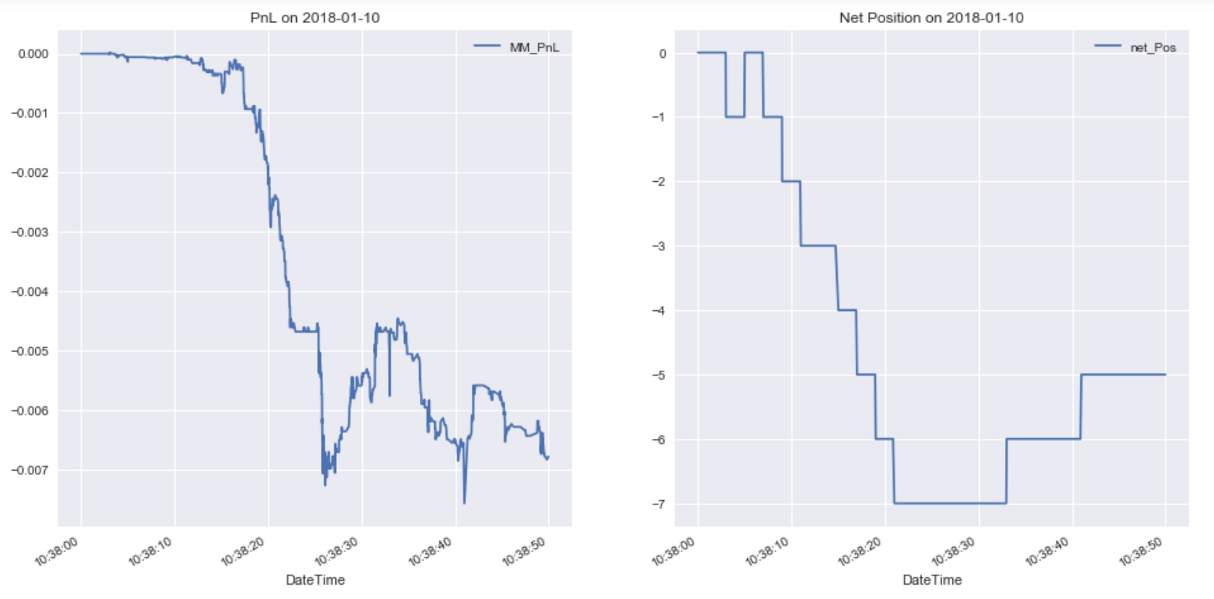
Position-Watcher Strategy

Slide 27
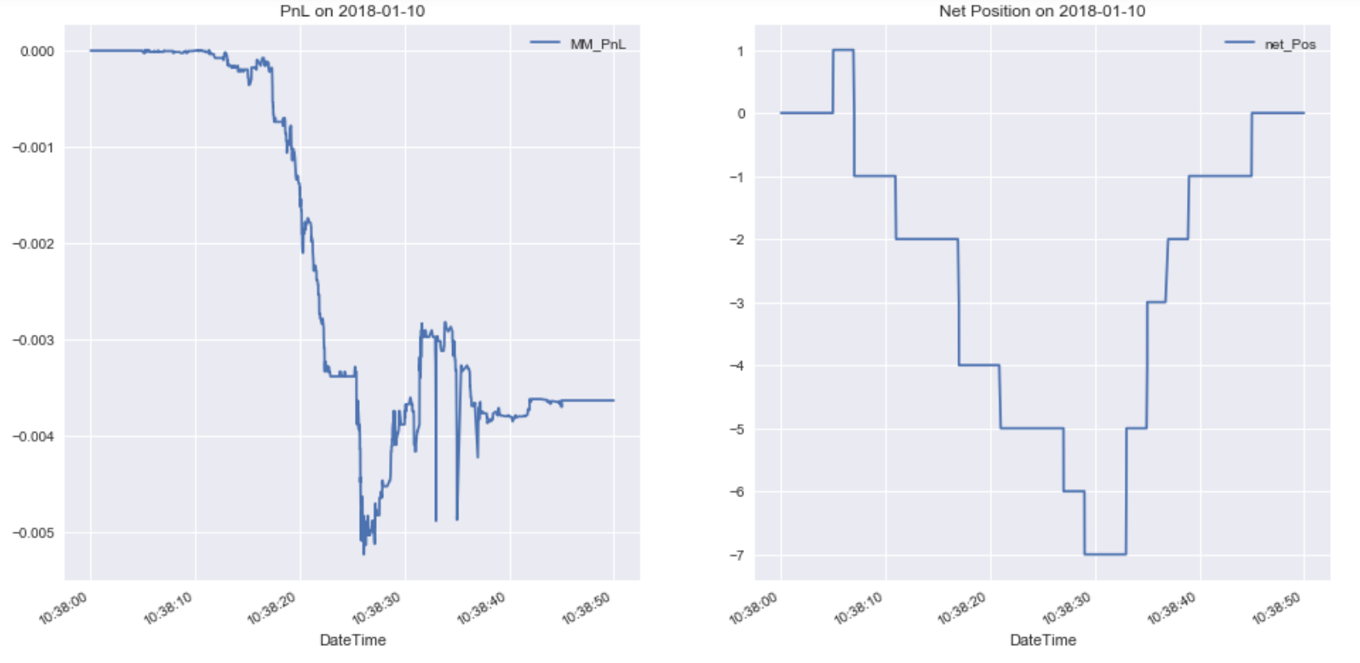
Trend Follower Strategy

Slide 28
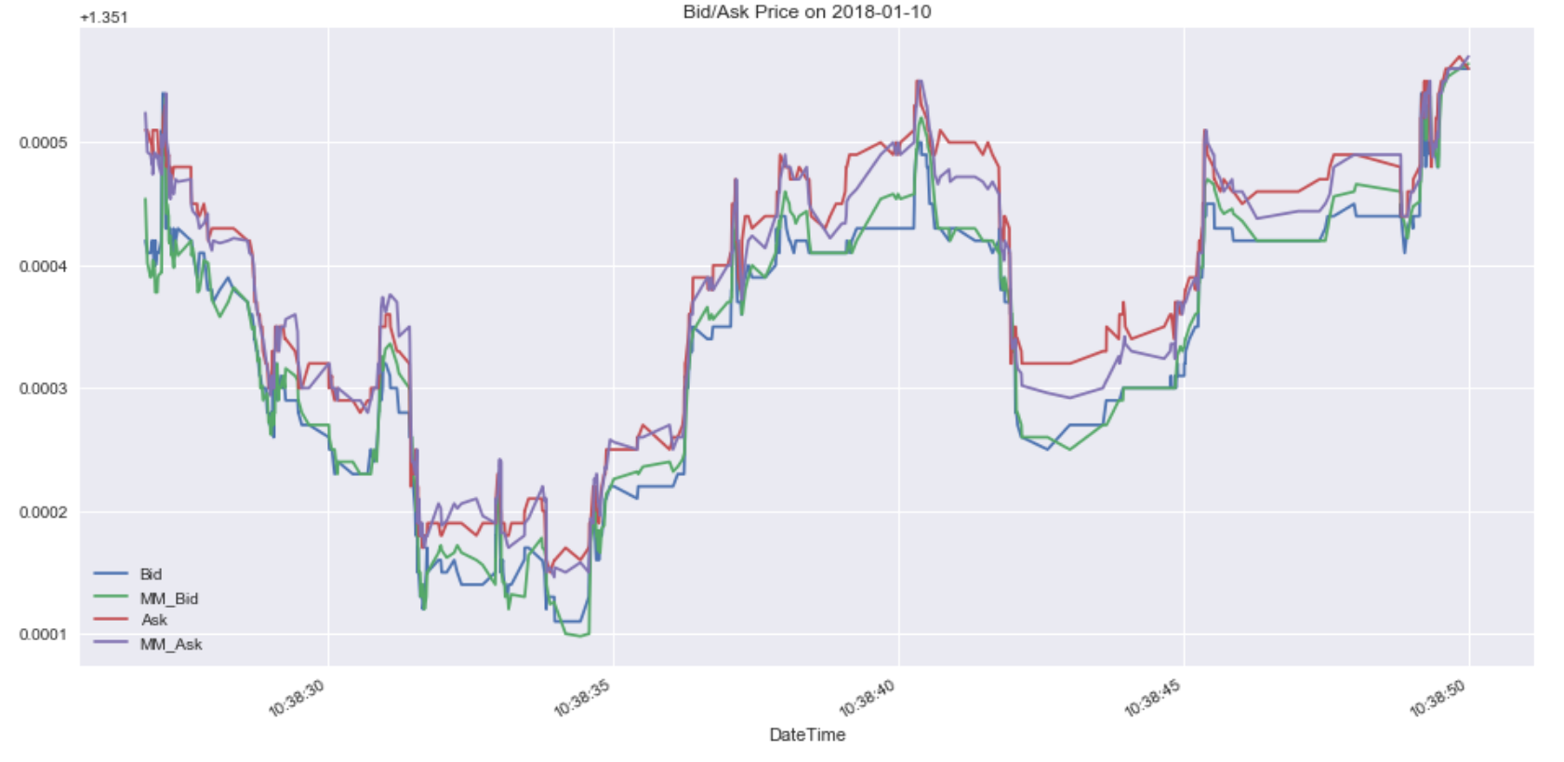

Slide 29
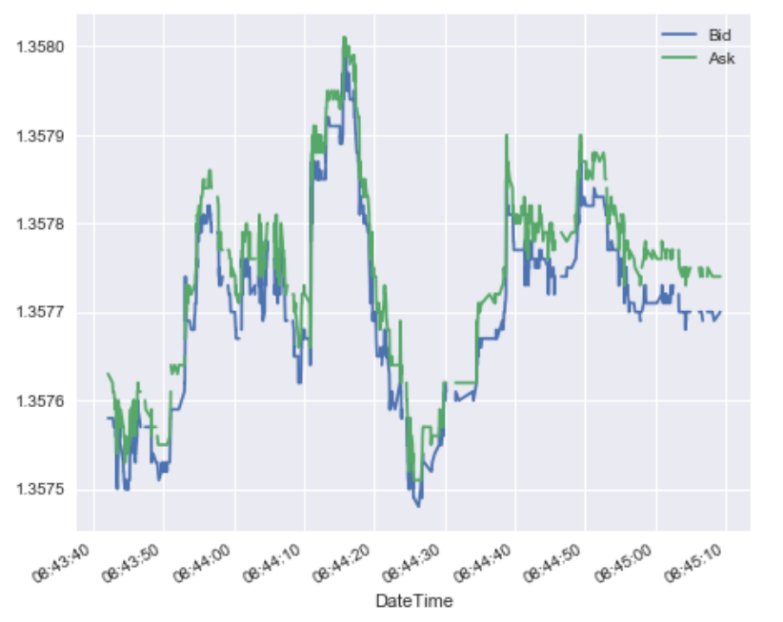
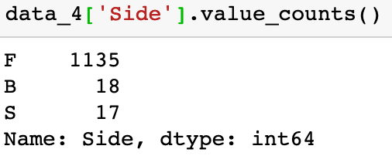
Order Period - 4
Mean Reversion and Breakout
Volatility and b/o spread are large
Participation return to balance at the end

Slide 30
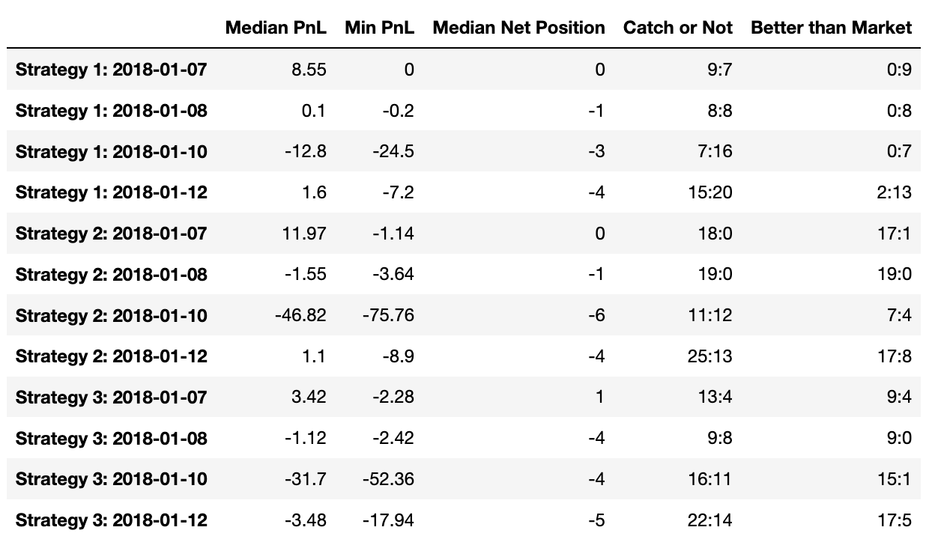
Recap Table

